Slide 1
Randomized Algorithms CS648
Lecture 14
Delay sequences
Random walk and Electric networks

Slide 2
Delay sequences

Slide 3







$n$ Counters
Each counter has a fair coin of its own.
0 0 0 0 0 0
$$1$$
$$2$$
$$i−1$$
$$i$$
$$i+1$$
$$n$$
H
T
T
H
T
T

Slide 4
$n$ Counters
Each counter has a fair coin of its own.
1 0 0 1 0 0
$$1$$
$$2$$
$$i−1$$
$$i$$
$$i+1$$
$$n$$
H
T
T
H
T
T

Slide 5

$n$ Counters
Each counter has a fair coin of its own.
Counter $C_{i}$ can increment only if
the coin it tosses gives HEADS.
Neither $C_{i−1}$nor $C_{i+1}$ has value less than $C_{i}$.
What is the number of rounds till each counter becomes $n$ ?
1 0 0 2 0 0
$$1$$
$$2$$
$$i−1$$
$$i$$
$$i+1$$
$$n$$

Slide 6
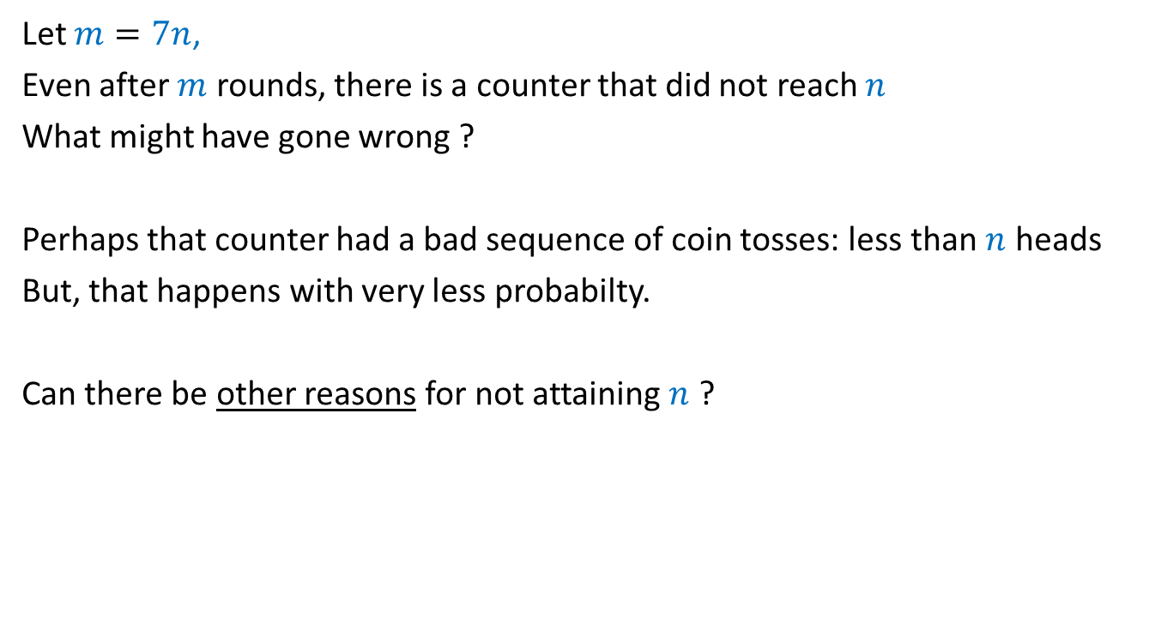
Let $m=7n$,
Even after $m$ rounds, there is a counter that did not reach $n$
What might have gone wrong ?
Perhaps that counter had a bad sequence of coin tosses: less than $n$ heads
But, that happens with very less probabilty.
Can there be other reasons for not attaining $n$ ?

Slide 7

Question
Can the bad coin tosses of a coin be the sole cause for the
experiment to fail (some counter does not reach $n$)
No

Slide 8










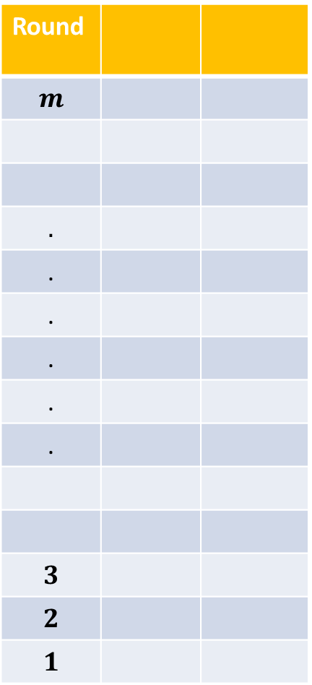




















Round
$$m$$
$$.$$
.
.
.
.
.
$$3$$
$$2$$
$$1$$
$$C_{1}$$
$$C_{2}$$
$$T$$
$$H$$
$$T$$
$$H$$
$$T$$
$$H$$
Hopefully, by now everyone is convinced about the “nontriviality” of the problem. ☺
$$⋮$$
$$⋮$$
$$1$$
$$1$$
$$2$$
$$0$$
$$T$$
$$H$$
$$C_{1}$$
$$C_{2}$$
$$T$$
$$H$$
$$H$$
$$T$$
$$H$$
$$T$$
$$H$$
$$T$$
$$⋮$$
$$⋮$$
$$H$$
$$T$$
$$H$$
$$T$$

Slide 9
Analysis using Delay Sequence
Key idea:
Pure scientific spirit to explain a phenomenon.

Slide 10
Warm up

Slide 11
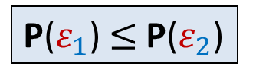

A question
Let $ε_{1}$ and $ε_{2}$ be any two events defined over a probability space.
Whenever $ε_{1}$ happens, $ε_{2}$ also happens.
$ε_{1}$ ➔ $ε_{2}$
Question: What is the relation between P($ε_{1}$) and P($ε_{2}$) ?
P($ε_{1}$) $≤$P($ε_{2}$)

Slide 12


















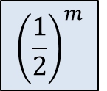











Round
Student
Outcome of coin toss
during the round
$$m$$
Shiv
$$T$$
$$m−1$$
Shiv
$$T$$
$$m−2$$
Shiv
$$H$$
$$m−3$$
$$⋮$$
$$T$$
$$m−4$$
$$H$$
$$m−5$$
$$H$$
$${\left(\frac{1}{2}\right)}^{m}$$
$$m−6$$
$$T$$
$$m−7$$
$$H$$
$$⋮$$
$$m−8$$
$$T$$
$$m−9$$
$$H$$
$$m−10$$
$$⋮$$
$$⋮$$
$$T$$
$$3$$
$$H$$
$$⋮$$
$$2$$
$$1$$
Shiv
$$⋮$$

Slide 13
Round
Student
Outcome of coin toss
during the round
$$m$$
Ritesh
Shiv
$$T$$
$$m−1$$
Jatin
$$T$$
Shiv
$$m−2$$
Saiteja
$$H$$
Shiv
$$m−3$$
Jatin
$$T$$
$$⋮$$
$$m−4$$
Waseem
$$H$$
$$m−5$$
Parul
$$H$$
Akarsh
$${\left(\frac{1}{2}\right)}^{m}$$
$$m−6$$
$$T$$
$$m−7$$
Yash
$$H$$
$$⋮$$
$$m−8$$
Paramansh
$$T$$
$$m−9$$
Rohin
$$H$$
$$m−10$$
Pranay
$$⋮$$
$$⋮$$
Nikhil
Prafull
$$T$$
$$3$$
Waseem
$$H$$
$$⋮$$
$$2$$
Rohin
Raghukul
$$⋮$$
$$1$$
Shiv

Slide 14
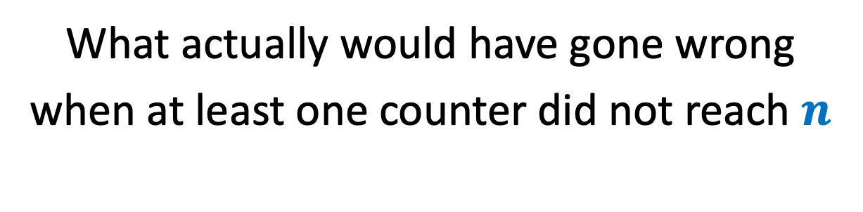
Let us start the investigation
What actually would have gone wrong
when at least one counter did not reach $n$

Slide 15















































Table formed to investigate the delay
Round
Counter
Counter value at the
end of the round
Outcome of coin toss
during the round
$$m$$
$$C_{i}$$
$$k$$
$$T$$
$$m−1$$
$$C_{i}$$
$$k$$
$$T$$
$$k$$
$$<n$$
$$m−2$$
$$C_{i}$$
$$k$$
$$H$$
$$m−3$$
$$C_{i}$$
$$T$$
$$i−2$$
$$i−1$$
$$i$$
$$k−1$$
$$m−4$$
$$C_{i}$$
$$k−1$$
$$H$$
$$m−5$$
$$C_{i}$$
$$k−1$$
$$H$$
$$C_{i−1}$$
$$k−2$$
$$m−6$$
$$C_{i−1}$$
$$k−3$$
$$T$$
$$m−7$$
$$C_{i−1}$$
$$k−3$$
$$H$$
$$m−8$$
$$C_{i−1}$$
$$k−3$$
$$C_{i−2}$$
$$k−4$$
$$T$$
$$m−9$$
$$C_{i−2}$$
$$k−4$$
$$H$$
$$m−10$$
?
?
$$⋮$$
$$⋮$$
$$⋮$$
$$⋮$$
$$C_{j}$$
$$ℓ$$
$$T$$
$$C_{j}$$
$$ℓ$$
$$H$$
$$C_{j±1}$$
$$C_{j}$$
$$ℓ−1$$
$$⋮$$
$$⋮$$
$$⋮$$
$$⋮$$

Slide 16
















Table formed to investigate the delay
Round
Counter
Counter value at the
end of the round
Outcome of coin toss
during the round
$$m$$
$$C_{i}$$
$$k$$
$$T$$
$$m−1$$
$$C_{i}$$
$$k$$
$$T$$
$$m−2$$
$$C_{i}$$
$$k$$
$$H$$
$$m−3$$
$$C_{i}$$
$$k−1$$
$$T$$
$$m−4$$
$$C_{i}$$
$$k−1$$
$$H$$
$$m−5$$
$$C_{i−1}$$
$$k−2$$
$$H$$
$$m−6$$
$$C_{i−1}$$
$$k−3$$
$$T$$
$$m−7$$
$$C_{i−1}$$
$$k−3$$
$$H$$
$$m−8$$
$$C_{i−2}$$
$$k−4$$
$$T$$
$$m−9$$
$$C_{i−2}$$
$$k−4$$
$$H$$
$$m−10$$
?
?
$$⋮$$
$$⋮$$
$$⋮$$
$$⋮$$
$$C_{j}$$
$$ℓ$$
$$T$$
$$C_{j}$$
$$ℓ$$
$$H$$
$$C_{j±1}$$
$$ℓ−1$$
$$⋮$$
$$⋮$$
$$⋮$$
$$⋮$$

Slide 17
Table formed to investigate the delay
Counter value at the
end of the round
Round
Counter
Outcome of coin toss
during the round
$$m$$
$$C_{i}$$
$$T$$
$$k$$
$$m−1$$
$$C_{i}$$
$$T$$
$$k$$
$$C_{i}$$
$$H$$
$$m−2$$
$$k$$
$$m−3$$
$$C_{i}$$
$$T$$
$$k−1$$
$$m−4$$
$$C_{i}$$
$$k−1$$
$$H$$
$$m−5$$
$$C_{i−1}$$
$$H$$
$$k−2$$
$$m−6$$
$$C_{i−1}$$
$$k−3$$
$$T$$
A delay sequence
$$m−7$$
$$C_{i−1}$$
$$H$$
$$k−3$$
$$m−8$$
$$C_{i−2}$$
$$T$$
$$k−4$$
$$m−9$$
$$C_{i−2}$$
$$k−4$$
$$H$$
$$m−10$$
?
?
$$⋮$$
$$⋮$$
$$⋮$$
$$⋮$$
$$C_{j}$$
$$T$$
$$ℓ$$
$$C_{j}$$
$$H$$
$$ℓ$$
$$C_{j±1}$$
$$ℓ−1$$
$$⋮$$
$$⋮$$
$$⋮$$
$$⋮$$

Slide 18
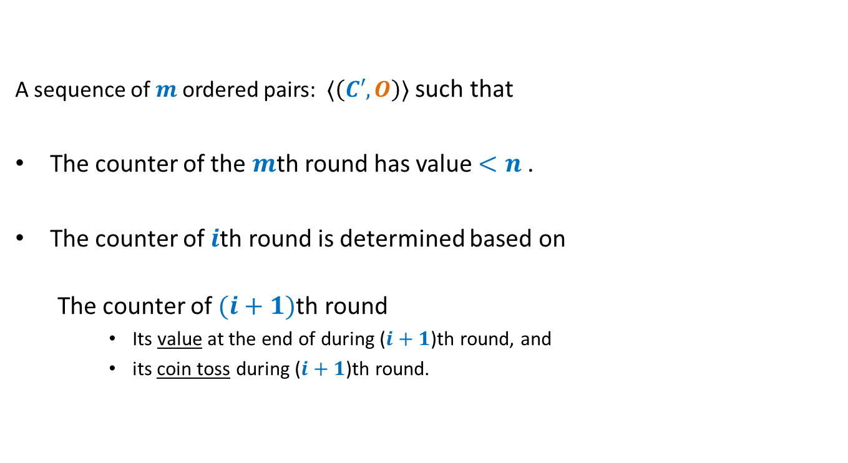
A delay sequence
A counter
A sequence of $m$ordered pairs: $⟨\left(C′,O\right)⟩$ such that
The counter of the $m$th round has value $<n$.
The counter of $i$th round is determined based on
The counter of $(i+1)$th round
Its value at the end of during ($i+1$)th round, and
its coin toss during ($i+1$)th round.
Outcome of its coin toss during a round

Slide 19


Round
$$m$$
$$.$$
.
.
.
.
.
$$3$$
$$2$$
$$1$$
$$C_{1}$$
$$C_{2}$$
$$C_{2}$$
$$H$$
$$T$$
$$H$$
$$T$$
$$H$$
$$T$$
$$H$$
$$⋮$$
$$⋮$$
$$1$$
$$1$$
$$2$$
$$0$$
$$T$$
$$H$$
$$C_{1}$$
$$C_{2}$$
$$T$$
$$H$$
$$H$$
$$T$$
$$H$$
$$T$$
$$H$$
$$T$$
$$⋮$$
$$⋮$$
$$H$$
$$T$$
$$H$$
$$T$$

Slide 20







Round
$$m$$
$$.$$
.
.
.
.
.
$$3$$
$$2$$
$$1$$
$$C_{1}$$
$$C_{2}$$
$$C_{2}$$
$$H$$
$$T$$
$$H$$
$$C_{1}$$
$$T$$
$$T$$
$$H$$
$$C_{1}$$
$$T$$
$$T$$
$$H$$
$$C_{1}$$
$$T$$
$$⋮$$
$$⋮$$
$$1$$
$$2$$
$$T$$
$$H$$
$$C_{1}$$
$$C_{2}$$
$$T$$
$$H$$
$$H$$
$$T$$
$$H$$
$$T$$
$$H$$
$$T$$
$$⋮$$
$$⋮$$
$$H$$
$$T$$
$$H$$
$$T$$
Homework:
Compute a delay sequence for this event.

Slide 21

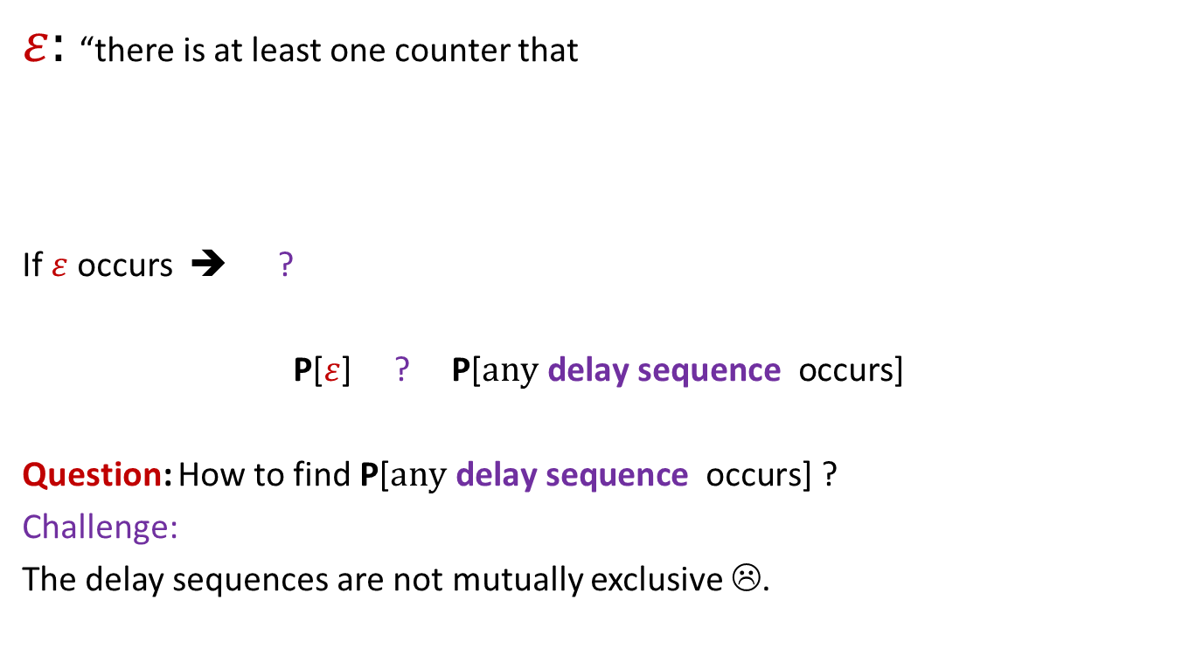

Why delay sequences ?
$ε:$ “there is at least one counter that
If $ε$ occurs ➔ ?
P[$ε$] ? P[$\text{a}\text{ny} \text{delay} \text{sequence} \text{occurs}$]
Question: How to find P[$\text{any} \text{delay} \text{sequence} \text{occurs}$] ?
Challenge:
The delay sequences are not mutually exclusive ☹.
did not attain value $n$ after $m$ rounds”
At least one delay sequence occurs
$$≤$$

Slide 22
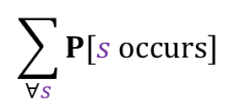

Why delay sequences ?
P[$\text{any} \text{delay} \text{sequence} \text{occurs}$] $≤$
➔
Question 1: How many delay sequences are there ?
Question 2: What can be the probability of a delay sequence ?
$$\sum_{∀s}{P[s occurs]}$$

Slide 23
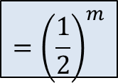

Table formed to investigate the delay
Counter value at the
end of the round
Round
Counter
Outcome of coin toss
during the round
$$m$$
$$C_{i}$$
$$T$$
$$k$$
$$m−1$$
$$C_{i}$$
$$T$$
$$k$$
Question 2:
How many delay sequences ?
$$C_{i}$$
$$H$$
$$m−2$$
$$k$$
$$m−3$$
$$C_{i}$$
$$T$$
$$k−1$$
$$m−4$$
$$C_{i}$$
$$k−1$$
$$H$$
Question 1:
What is the probability of a delay sequence ?
$$m−5$$
$$C_{i−1}$$
$$H$$
$$k−2$$
$$m−6$$
$$C_{i−1}$$
$$k−3$$
$$T$$
$$m−7$$
$$C_{i−1}$$
$$H$$
$$k−3$$
$$m−8$$
$$C_{i−2}$$
$$T$$
$$k−4$$
$$m−9$$
$$C_{i−2}$$
$$k−4$$
$$H$$
$${=\left(\frac{1}{2}\right)}^{m}$$
$$m−10$$
?
?
$$⋮$$
$$⋮$$
$$⋮$$
$$n$$
$$⋮$$
$$C_{j}$$
$$T$$
$$ℓ$$
$$C_{j}$$
$$H$$
$$ℓ$$
$$C_{j±1}$$
$$ℓ−1$$
$$⋮$$
$$⋮$$
$$⋮$$
$$⋮$$

Slide 24




Table formed to investigate the delay
Round
Counter
Counter value at the
end of the round
Outcome of coin toss
during the round
$$m$$
$$C_{i}$$
$$k$$
$$T$$
$$m−1$$
$$C_{i}$$
$$k$$
$$T$$
Question 2:
How many delay sequences ?
$$m−2$$
$$C_{i}$$
$$k$$
$$H$$
$$m−3$$
$$C_{i}$$
$$k−1$$
$$T$$
$$m−4$$
$$C_{i}$$
$$k−1$$
$$H$$
$$m−5$$
$$C_{i−1}$$
$$k−2$$
$$H$$
$$m−6$$
$$C_{i−1}$$
$$k−3$$
$$T$$
Exactly $k$
$$m−7$$
$$C_{i−1}$$
$$k−3$$
$$H$$
$$m−8$$
$$C_{i−2}$$
$$k−4$$
$$T$$
$$⋮$$
$$m−9$$
$$C_{i−2}$$
$$k−4$$
$$H$$
$$m−10$$
?
?
$$\left({m \atop k}\right)$$
$$⋮$$
$$⋮$$
$$⋮$$
$$⋮$$
$$n$$
$$n$$
$$C_{j}$$
$$ℓ$$
$$T$$
$$C_{j}$$
$$ℓ$$
$$H$$
$$C_{j±1}$$
$$ℓ−1$$
$$⋮$$
$$⋮$$
$$⋮$$
$$⋮$$

Slide 25

Table formed to investigate the delay
Counter value at the
end of the round
Round
Counter
Outcome of coin toss
during the round
$$m$$
$$C_{i}$$
$$T$$
$$k$$
$$m−1$$
$$C_{i}$$
$$T$$
$$k$$
Question 2:
How many delay sequences ?
$$C_{i}$$
$$H$$
$$m−2$$
$$k$$
$$m−3$$
$$C_{i}$$
$$T$$
$$k−1$$
$$m−4$$
$$C_{i}$$
$$k−1$$
$$H$$
$$m−5$$
$$C_{i−1}$$
$$H$$
$$k−2$$
$$m−6$$
$$C_{i−1}$$
$$k−3$$
$$T$$
$$m−7$$
$$C_{i−1}$$
$$H$$
$$k−3$$
$$m−8$$
$$C_{i−2}$$
$$T$$
$$k−4$$
$$m−9$$
$$C_{i−2}$$
$$k−4$$
$$H$$
$$m−10$$
?
?
$$\left({m \atop k}\right)$$
$${\left(3\right)}^{k}$$
$$⋮$$
$$⋮$$
$$⋮$$
$$n$$
$$n$$
$$⋮$$
$$C_{j}$$
$$T$$
$$ℓ$$
$$C_{j}$$
$$H$$
$$ℓ$$
$$C_{j±1}$$
$$ℓ−1$$
$$⋮$$
$$⋮$$
$$⋮$$
$$⋮$$

Slide 26
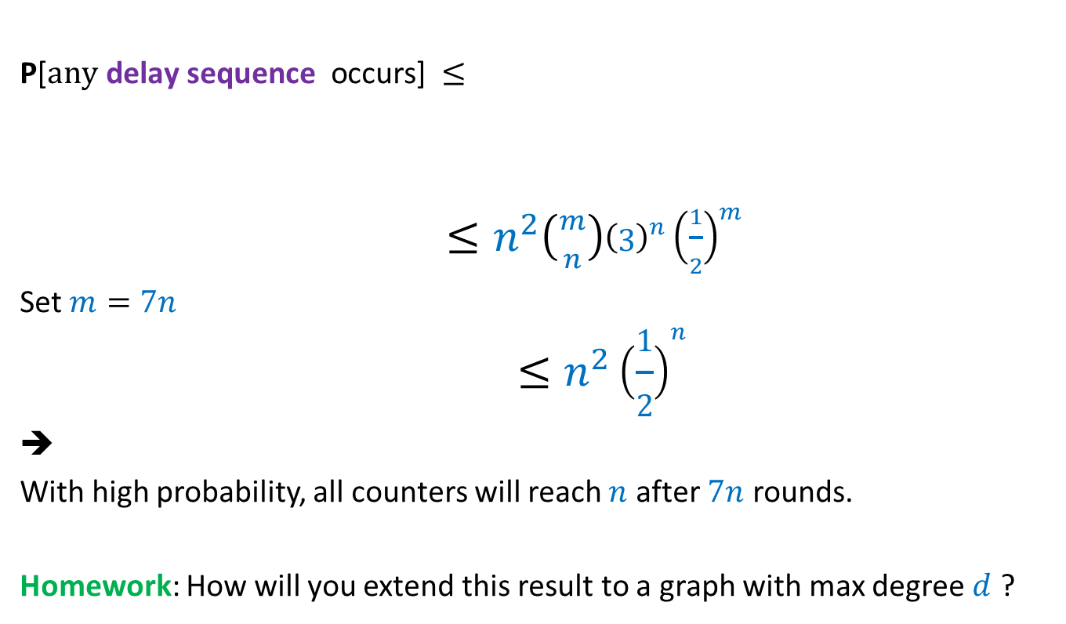



Why delay sequences ?
P[$\text{any} \text{delay} \text{sequence} \text{occurs}$] $≤$
$≤n^{2}\left({m \atop n}\right){\left(3\right)}^{n}{\left(\frac{1}{2}\right)}^{m}$
Set $m=7n$
$$≤n^{2}{\left(\frac{1}{2}\right)}^{n}$$
➔
With high probability, all counters will reach $n$ after $7n$ rounds.
Homework: How will you extend this result to a graph with max degree $d$ ?
= ?
$$\sum_{∀s}{P[s occurs]}$$
Since $\left({m \atop n}\right)≤{\left(\frac{em}{n}\right)}^{n}$
So $\left({m \atop n}\right)3^{n}<{\left(21e\right)}^{n}<{63}^{n}$
${\left(\frac{1}{2}\right)}^{m}<{\left(\frac{1}{128}\right)}^{n}$

Slide 27
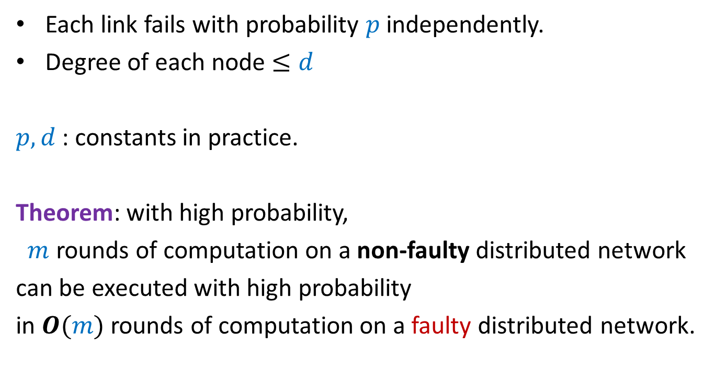
Faulty network
Each link fails with probability $p$ independently.
Degree of each node $≤d$
$p,d$ : constants in practice.
Theorem: with high probability,
$m$ rounds of computation on a non-faulty distributed network
can be executed with high probability
in $O(m)$ rounds of computation on a faulty distributed network.

Slide 28
The Power of two choices
Another magical application

Slide 29



Balls into Bins
1 2 3 4 5 … $m−1$ $m$
Ball-bin Experiment: There are $m$ balls and $n$ bins.
Each ball selects its bin randomly uniformly and independent of other balls
and falls into it.
Applications:
Hashing
Load balancing in distributed environment
1 2 3 … $i$ … $n$

Slide 30
Balls into Bins
1 2 3 4 i … $m−1 m$
1 2 3 … $i$ … $n$

Slide 31
Balls into Bins
i … $m−1 m$
1 2 3 … $j$ … $n$

Slide 32
Balls into Bins
i … $m−1 m$
1 2 3 … $j$ … $n$

Slide 33


Balls into Bins
1 2 3 4 5 … $m−1 m$
Question : What is the load of most heavily loaded bin ?
The analysis is based on arguments similar to the “delay sequence” for the counter problem. But it is beyond the scope of this course.
1 2 3 … $i$ … $n$
O($log\log{n}$)

Slide 34
Random walk and Electric Networks
Doyle and Snell
https://math.dartmouth.edu/~doyle/docs/walks/walks.pdf

Slide 35
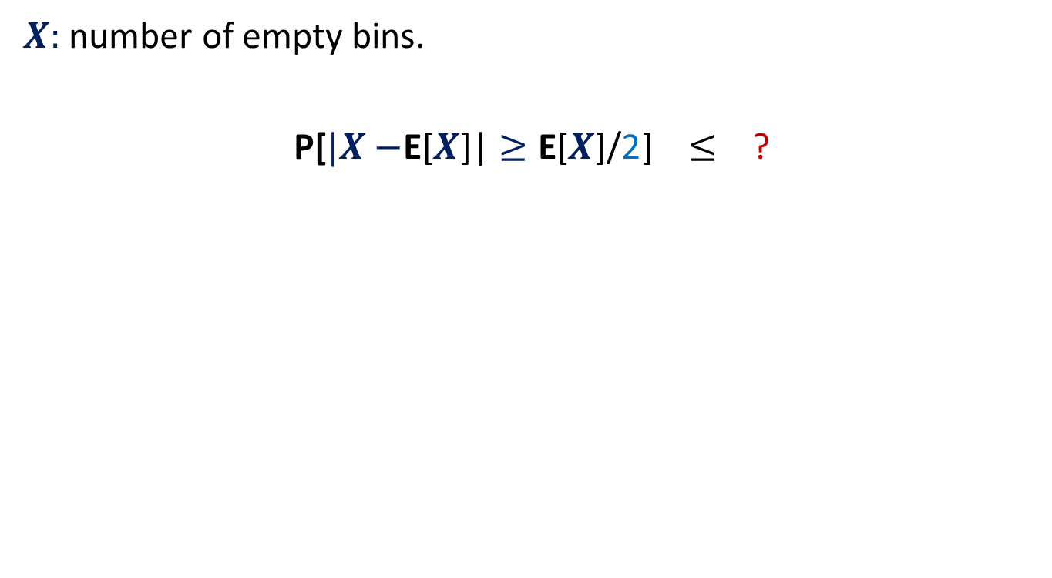







Random walk on a line
½
½
Question:
Suppose the random walk starts at $i$.
The walk terminates as soon as drunkard reaches home or bar.
What is the probability that the drunkard reaches home before reaching bar ?
Let $p(i)$ be the corresponding probability.
$p\left(0\right)=$ ?
$p\left(n\right)=$ ?
$p\left(i\right)=$ ?
bar
home
$$0$$
$$1$$
$$i−1$$
$$i$$
$$i+1$$
$$n−1$$
$$n$$
$$0$$
$$1$$
$$\frac{1}{2}p\left(i−1\right) + \frac{1}{2}p\left(i+1\right)$$

Slide 36
Random walk on a line
$V\left(i\right)$: Potential at point $i$.
$V\left(0\right)=0$, $V\left(n\right)=1$,
Current entering $i$ = Current leaving $i$.
$\frac{\left(V\left(i+1\right)−V\left(i\right)\right)}{1}$ = $\frac{\left(V\left(i\right)−V\left(i−1\right)\right)}{1}$
$V\left(i\right)=$ $\frac{1}{2}\left(V\left(i−1\right) + V\left(i+1\right)\right)$
current
$$0$$
$$1$$
$$i−1$$
$$i$$
$$i+1$$
$$n−1$$
$$n$$
$1$ Volt
Each resistance is 1 ohm.

Slide 37
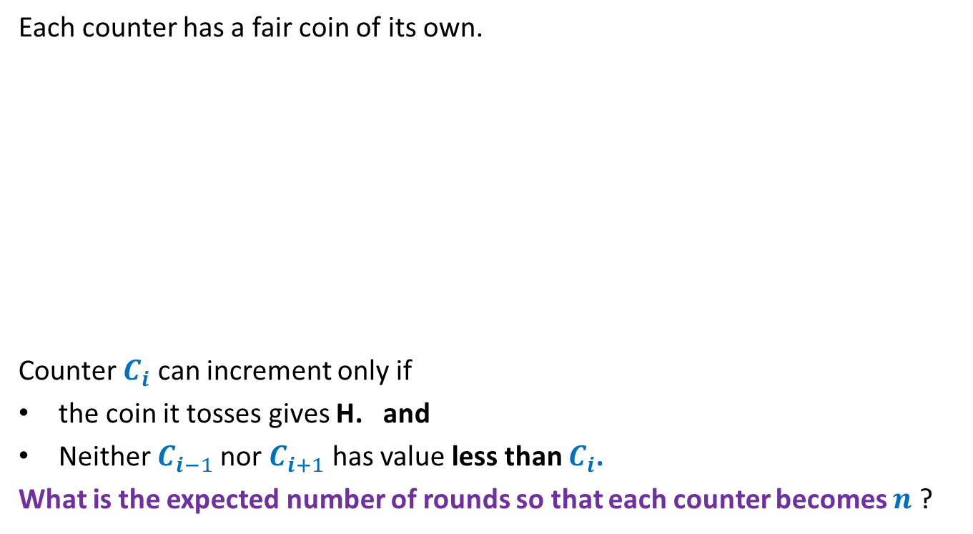

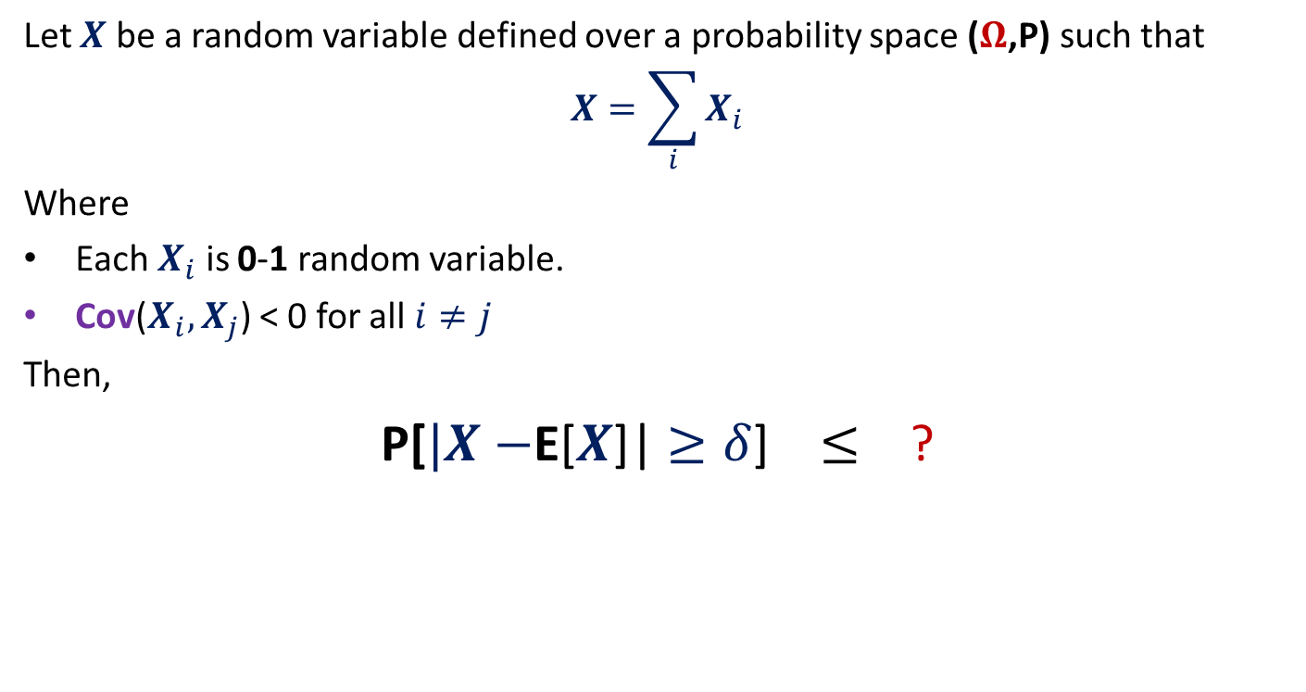

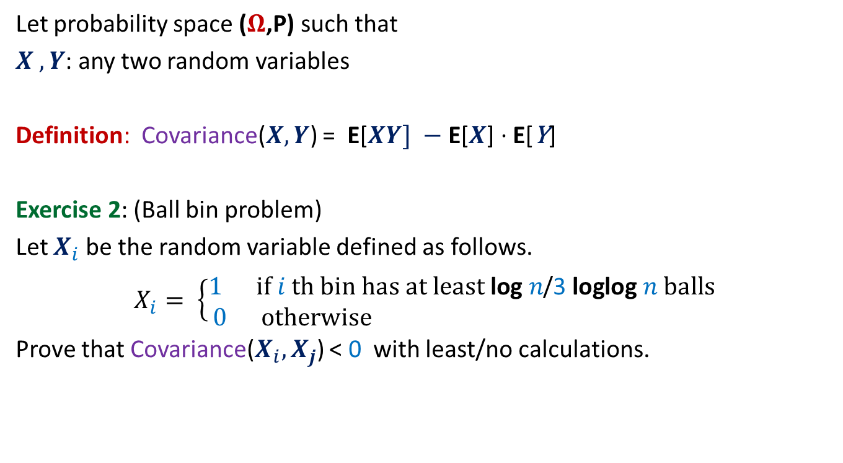



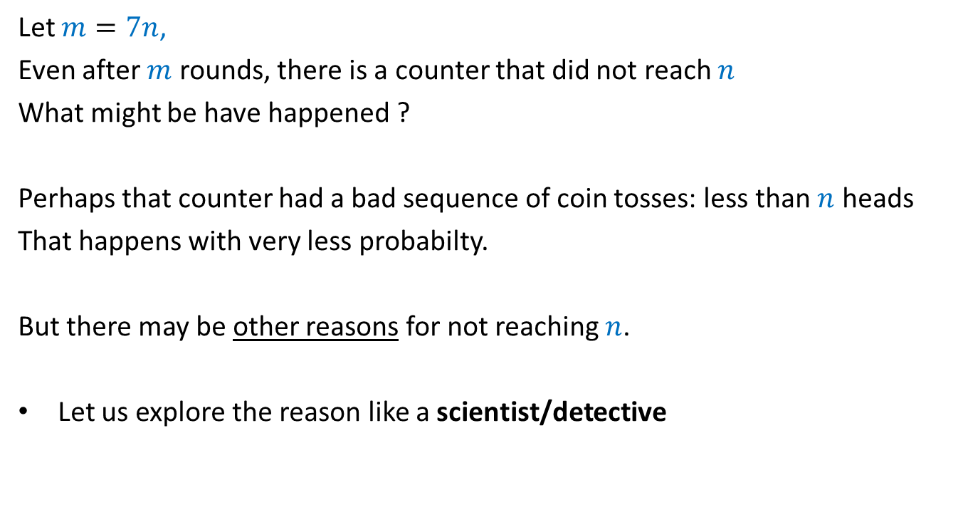
Random walk on a line
½
½
$p\left(0\right)=0$, $p\left(n\right)=1$, $p\left(i\right)=$ $\frac{1}{2}\left(p\left(i−1\right) + p\left(i+1\right)\right)$
$V\left(i\right)$: Potential at point $i$
$V\left(0\right)=0$, $V\left(n\right)=1$, $V\left(i\right)=$ $\frac{1}{2}\left(V\left(i−1\right) + V\left(i+1\right)\right)$
Hence $V\left(i\right)$ and $p\left(i\right)$ satisfy the same set of equations.
➔ If these equations have unique solution, then $V\left(i\right)=p\left(i\right)$ for all $i$.
bar
home
$$0$$
$$1$$
$$i−1$$
$$i$$
$$i+1$$
$$n−1$$
$$n$$
current
$$0$$
$$1$$
$$i−1$$
$$i$$
$$i+1$$
$$n−1$$
$$n$$
$1$ Volt

Slide 38


Harmonic function in 1-dimension
Definition: function $f$ defined on [$0,n$] is said to be harmonic function if
at each internal point $i$
Lemma: A harmonic function attains its maximum (and minimum) value at
the boundary points.
$f$($i$) = $\frac{1}{2}\left(f\text{(}i−1\text{)}\text{ +}f\text{(}i+1\text{)}\right)$
$$0$$
$$1$$
$$i−1$$
$$i$$
$$i+1$$
$$n−1$$
$$n$$
Boundary point
Boundary point
Internal points

Slide 39
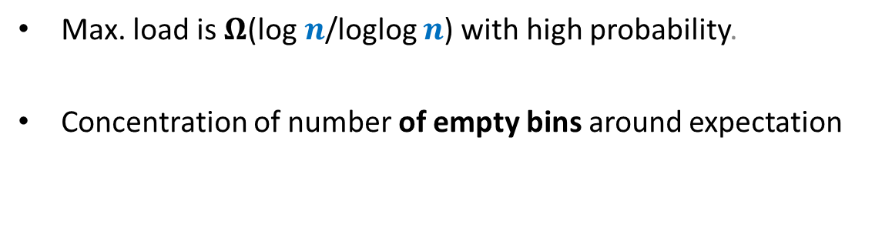
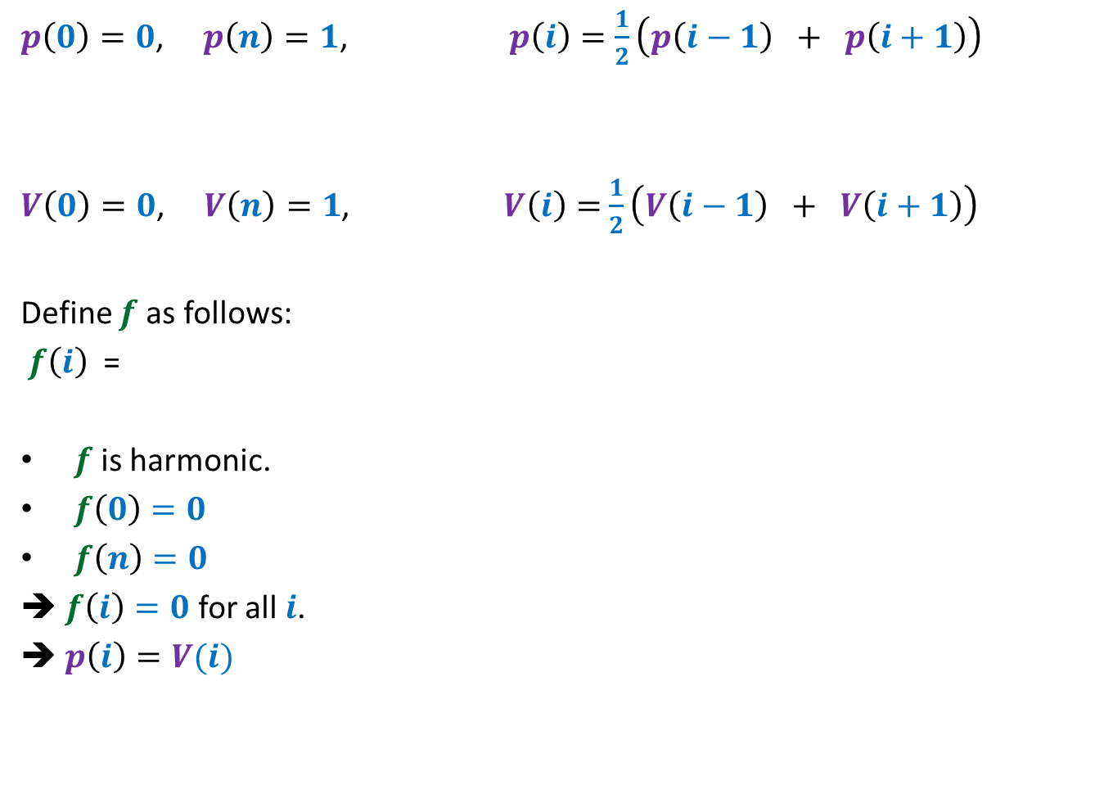
Random walk on a line
$p\left(0\right)=0$, $p\left(n\right)=1$, $p\left(i\right)=$ $\frac{1}{2}\left(p\left(i−1\right) + p\left(i+1\right)\right)$
$V\left(0\right)=0$, $V\left(n\right)=1$, $V\left(i\right)=$ $\frac{1}{2}\left(V\left(i−1\right) + V\left(i+1\right)\right)$
Define $f$ as follows:
$f\left(i\right)$ =
$f$ is harmonic.
$f\left(0\right)=0$
$f\left(n\right)=0$
➔ $f\left(i\right)=0$ for all $i$.
➔ $p\left(i\right)=V(i)$
$$p\left(i\right)−V(i)$$

Slide 40


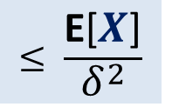
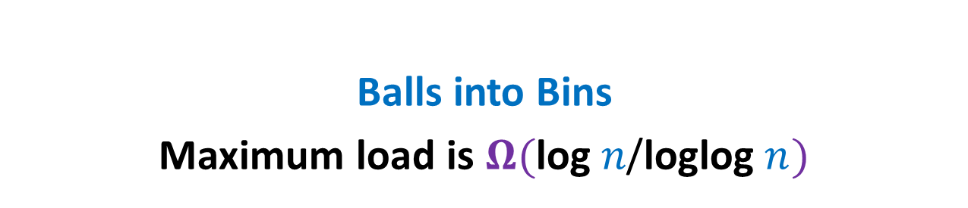
$$y$$
$$b$$
home
Question: What is $p_{x}$, probability of reaching home before bar ?
$p_{v}=0$,
$p_{c}=1$,
$p_{x}=\frac{1}{ deg(x) }\sum_{y∈N(x)}{p_{y}}$
$$c$$
bar
$$v$$
$$x$$
$$u$$
$$g$$
$$d$$
$$a$$
$$z$$

Slide 41

1 volt
$$y$$
$$b$$
Question: What is relation between $V_{x}$ and $V_{y}$’s where $y∈N(x)$ ?
$V_{v}=0$,
$V_{c}=1$,
Net current leaving $x$is 0.
$\sum_{y∈N(x)}{{(V}_{x}−V_{y}) \text{=0}}$
➔ $V_{x}=\frac{1}{ deg(x) }\sum_{y∈N(x)}{V_{y}}$
$$c$$
$$v$$
$$x$$
$$u$$
$$g$$
$$d$$
$$a$$
$$z$$

Slide 42
$$y$$
$$b$$
Question: What is relation between $V_{x}$ and $V_{y}$’s where $y∈N(x)$ ?
$V_{v}=0$,
$V_{c}=1$,
$$V_{x}=\frac{1}{ deg(x) }\sum_{y∈N(x)}{V_{y}}$$
Hence $V_{x}$ and $p_{x}$ satisfy the same set of equations.
➔ Since these equations have unique solution, therefore $V_{x}=p_{x}$ for all $x$.
$$c$$
$$v$$
$$x$$
$$u$$
$$g$$
$$d$$
$$a$$
$$z$$
$p_{v}=0$,
$p_{c}=1$,
$$p_{x}=\frac{1}{ deg(x) }\sum_{y∈N(x)}{p_{y}}$$

Slide 43
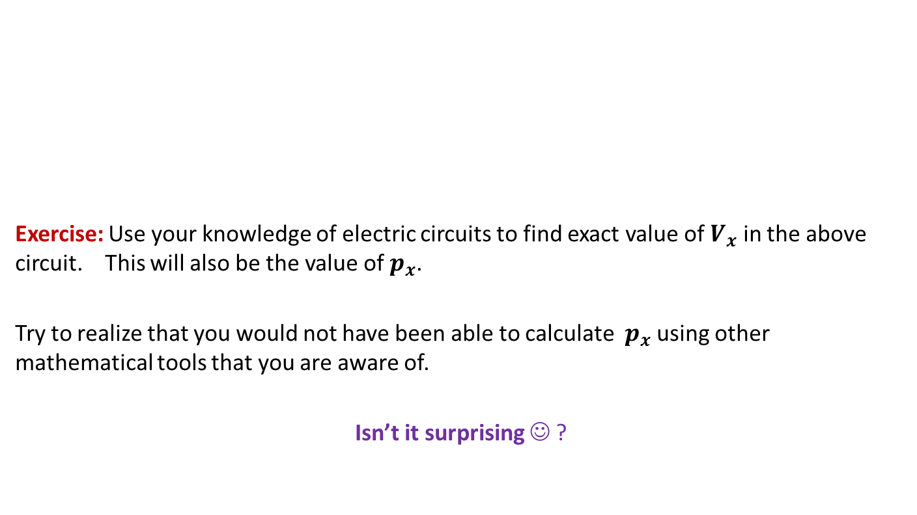
$$y$$
$$b$$
Exercise: Use your knowledge of electric circuits to find exact value of $V_{x}$ in the above circuit. This will also be the value of $p_{x}$.
Try to realize that you would not have been able to calculate $p_{x}$ using other mathematical tools that you are aware of.
Isn’t it surprising ☺ ?
$$c$$
$$v$$
$$x$$
$$u$$
$$g$$
$$d$$
$$a$$
$$z$$

Slide 44
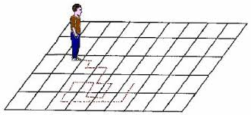
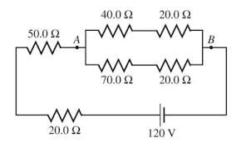
A surprising discovery
Random walk
Electric networks
A. K. Chandra, P. Raghavan, W. L. Ruzzo, R. Smolensky, P. Tiwari: The Electrical Resistance of a Graph Captures its Commute and Cover Times
(Detailed Abstract). STOC1989: 574-586

Slide 45





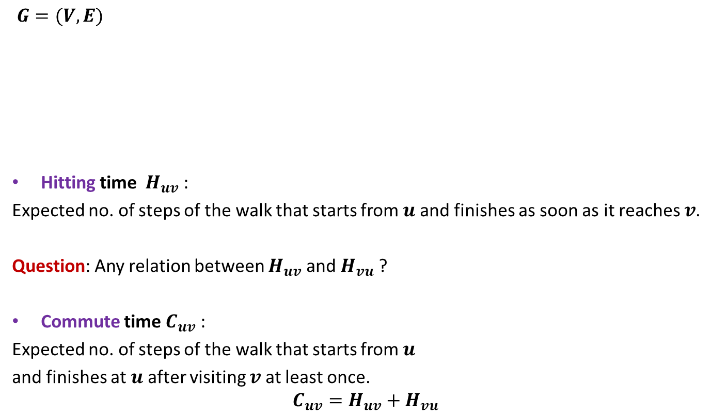






Notations
$$j$$
$$y$$
$$b$$
$G=(V,E)$
Hitting time $H_{uv}$ :
Expected no. of steps of the walk that starts from $u$ and finishes as soon as it reaches $v$.
Question: Any relation between $H_{uv}$ and $H_{vu}$ ?
Commute time $C_{uv}$ :
Expected no. of steps of the walk that starts from $u$
and finishes at $u$ after visiting $v$at least once.
$$C_{uv}=H_{uv}+H_{vu}$$
$$c$$
$$v$$
$$x$$
$$u$$
$$g$$
$$d$$
$$a$$
$$z$$
NO

Slide 46


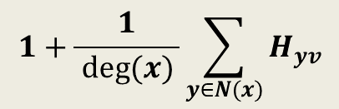
Expressing $H_{xv}$ through equations
$$y$$
$$b$$
$H_{xv}=$ ?
$$c$$
$$v$$
$$x$$
$$u$$
$$g$$
$$d$$
$$a$$
$$z$$
$$1+\frac{1}{ deg(x) }\sum_{y∈N(x)}{H_{yv}}$$

Slide 47
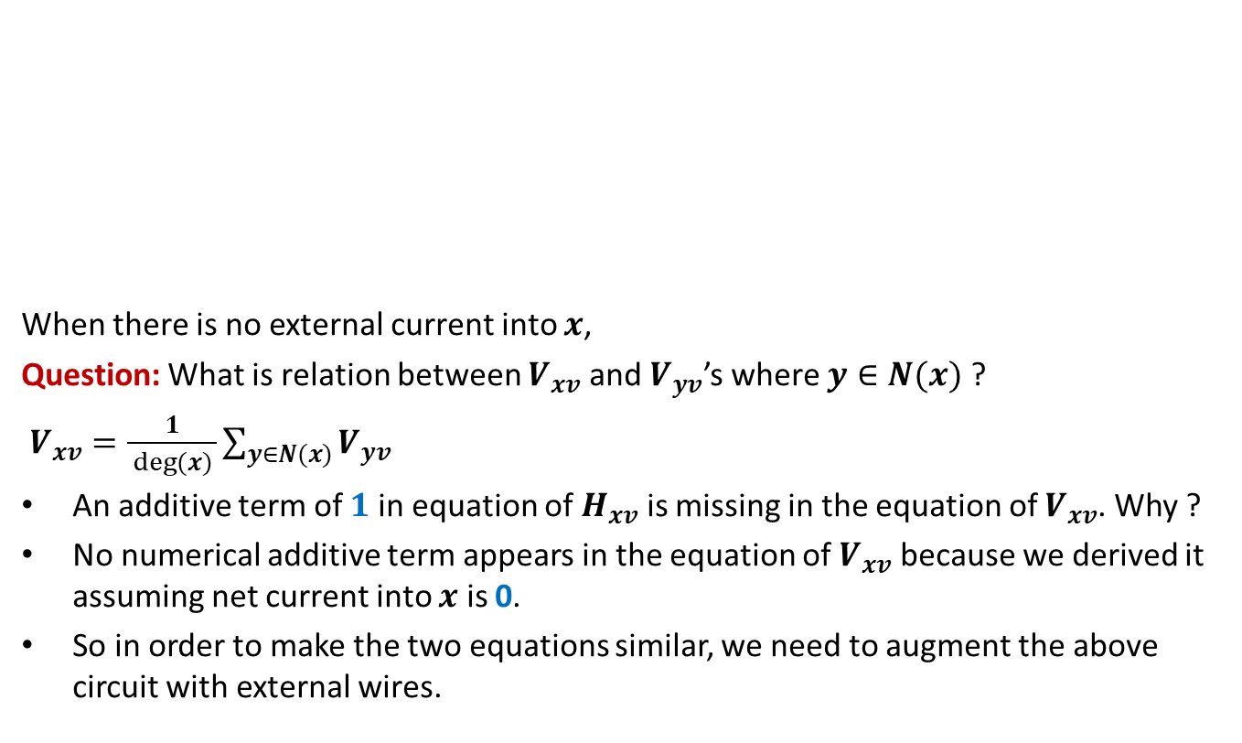

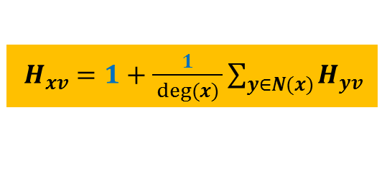
Expressing $H_{xv}$ through a circuit
$$y$$
$$b$$
When there is no external current into $x$,
Question: What is relation between $V_{xv}$ and $V_{yv}$’s where $y∈N(x)$ ?
$V_{xv}=\frac{1}{ deg(x) }\sum_{y∈N(x)}{V_{yv}}$
An additive term of $1$ in equation of $H_{xv}$ is missing in the equation of $V_{xv}$. Why ?
No numerical additive term appears in the equation of $V_{xv}$ because we derived it assuming net current into $x$ is 0.
So in order to make the two equations similar, we need to augment the above circuit with external wires.
$$c$$
$$v$$
$$x$$
$$u$$
$$g$$
$$d$$
$$a$$
$$z$$
$H_{xv}=1+\frac{1}{ deg(x) }\sum_{y∈N(x)}{H_{yv}}$

Slide 48


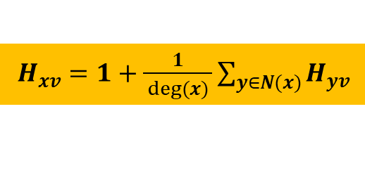
Expressing $H_{xv}$ through a circuit
$$y$$
$$b$$
Let $I_{x}$ be the current injected into $x$ from outside.
Question: What is the new relation between $V_{xv}$ and $V_{yv}$’s where $y∈N(x)$ ?
$V_{xv}=\frac{I_{x}}{deg(x)}+\frac{1}{ deg(x) }\sum_{y∈N(x)}{V_{yv}}$
Question: What should be $I_{x}$ in order to equate equations of $V_{xv}$ and $H_{xv}$?
➔ We must extract $2m−deg(v)$ current from $v$ to satisfy Kirchoff’s current law.
$$c$$
$$v$$
$$x$$
$$u$$
$$g$$
$$d$$
$$a$$
$$z$$
$H_{xv}=1+\frac{1}{ deg(x) }\sum_{y∈N(x)}{H_{yv}}$
$$I_{x}=deg(x)$$

Slide 49
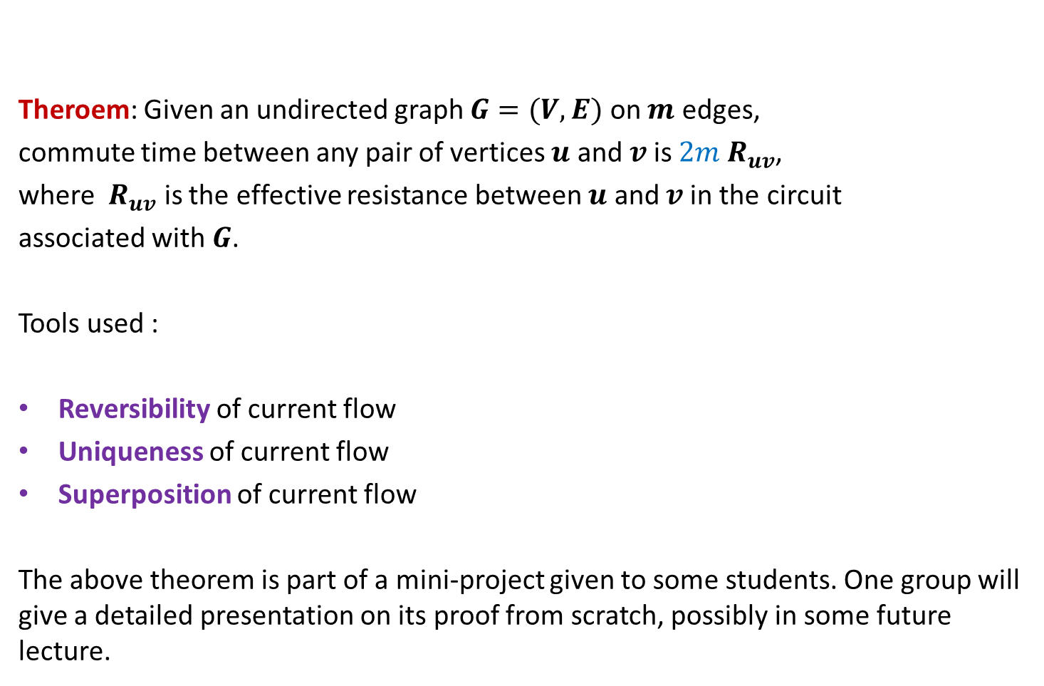
Theroem: Given an undirected graph $G=(V,E)$ on $m$ edges,
commute time between any pair of vertices $u$ and $v$is $2m{ R}_{uv}$,
where ${ R}_{uv}$ is the effective resistance between $u$ and $v$in the circuit
associated with $G$.
Tools used :
Reversibility of current flow
Uniqueness of current flow
Superposition of current flow
The above theorem is part of a mini-project given to some students. One group will give a detailed presentation on its proof from scratch, possibly in some future lecture.

